Slide 1
Back end Development

Slide 2
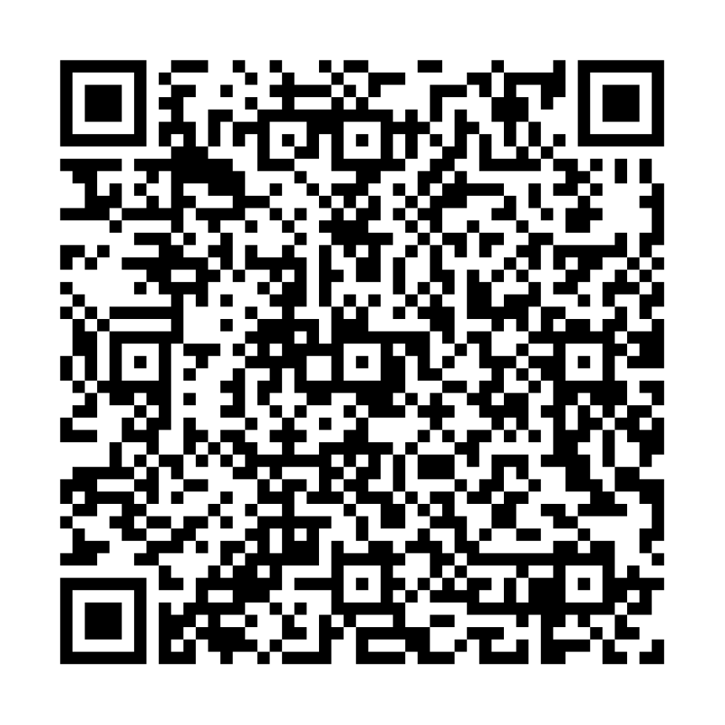
Made By
Ahmed Mohamed Abubakr
Electronics engineer IC designer
Full stack web developer
Ambassador at TIEC-IA

Slide 3
Tools needed in this part
Vscode
Xampp or wampp
Cmder (preferd than normal cmd)
To consentrate and be calm

Slide 4
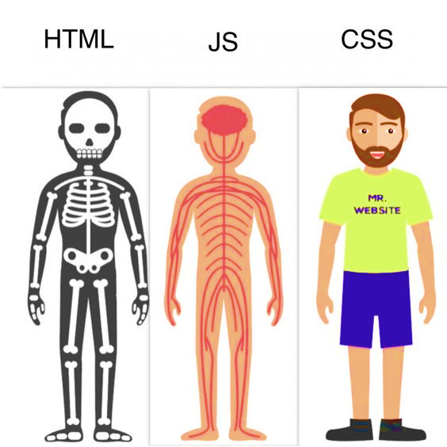

Slide 5
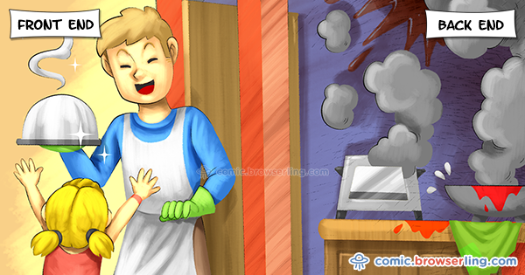

Slide 6


Slide 7
Back-end ?
What is use of back end ?
What I need to run the code ?
Is there any other languages like php ?

Slide 8
Alternatives to PHP
Practical extraction and Report Language (Perl)
Active Server Pages (ASP)
Java server pages (JSP)
Ruby
Django

Slide 9
PHP History
1994: Created by Rasmis Lesdorf, software engineer (part of Apache Team)
1995: Called Personal Home Page Tool, then released as version 2 with name PHP/FI (Form Interpreter, to analyse SQL queries)
Half 1997: used by 50,000 web sites
October 1998: used by 100,000 websites
End 1999: used by 1,000,000 websites

Slide 10
(Good) Topics about PHP
Open-source
Easy to use ( C-like and Perl-like syntax)
Stable and fast
Multiplatform
Many databases support
Many common built-in libraries
Pre-installed in Linux distributions

Slide 11
Hello World! (web oriented)
<?php
echo “hello world”;
?>

Slide 12
Hello World! (web oriented)
<html>
<head>
<title>My personal Hello World! PHP script</title>
</head>
<body>
<?php
echo “Hello World!”;
?>
</html>

Slide 13
How PHP generates HTML/JS Web pages
Client Browser
1
4
3
PHP module
Apache
2
Client from browser send HTTP request (with POST/GET variables)
Apache recognizes that a PHP script is requested and sends the request to PHP module
PHP interpreter executes PHP script, collects script output and sends it back
Apache replies to client using the PHP script output as HTML output

Slide 14
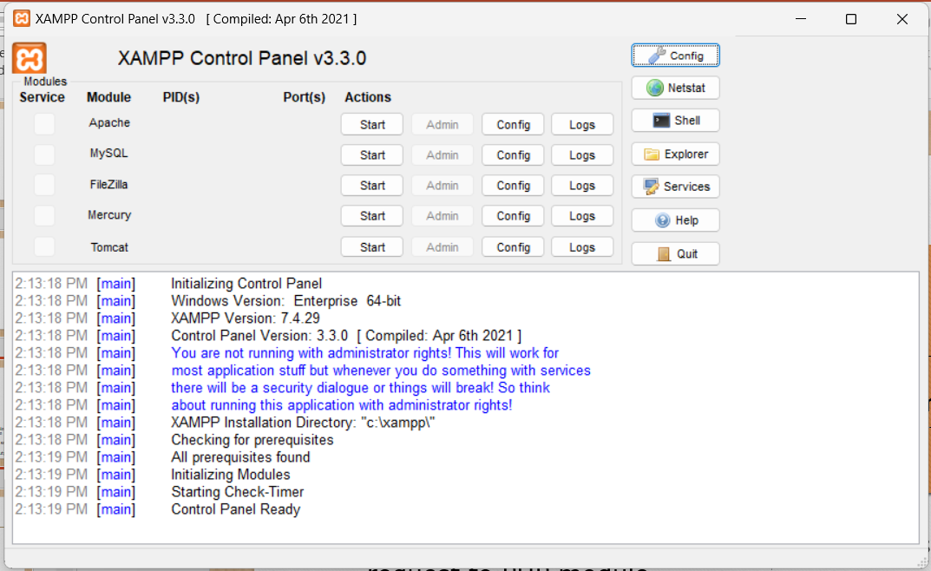

Slide 15
Lets talk about PHP
Syntax
Variables / Constants & datatypes
Conditional Statements
Loops
Arrays
Functions

Slide 16
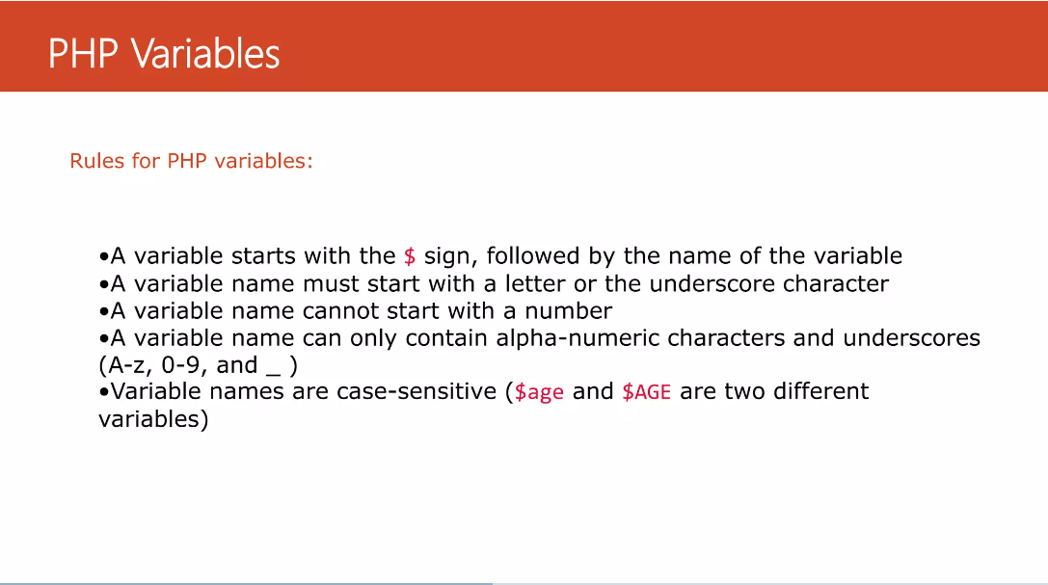

Slide 17
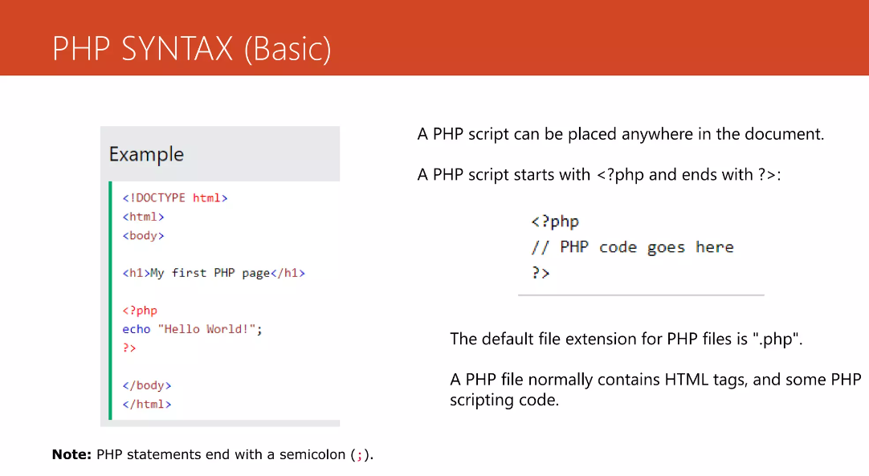

Slide 18
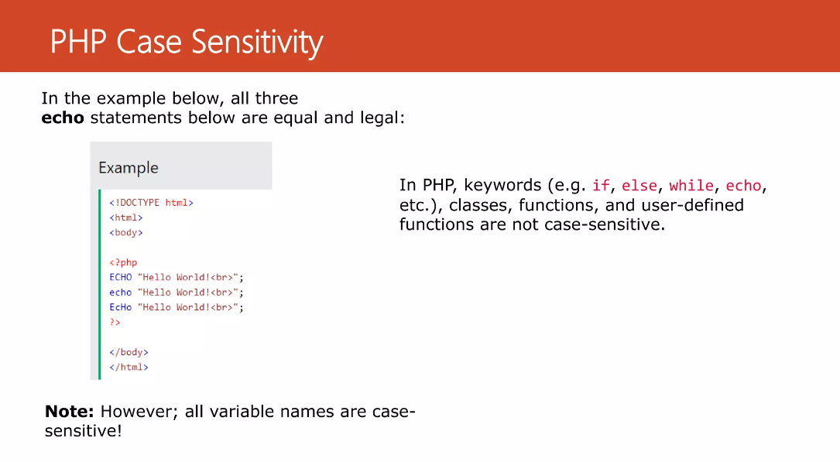

Slide 19
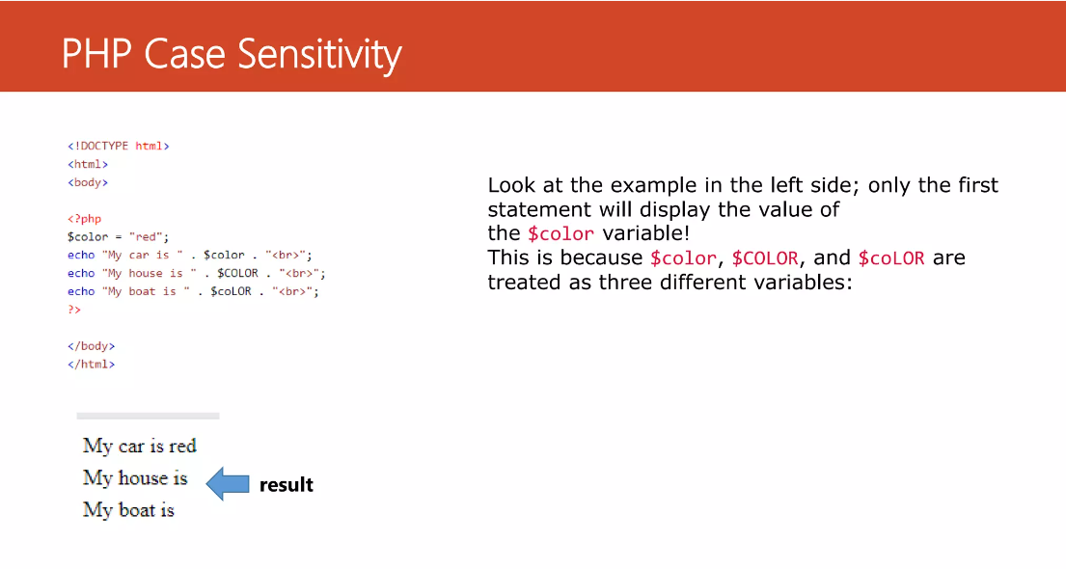

Slide 20
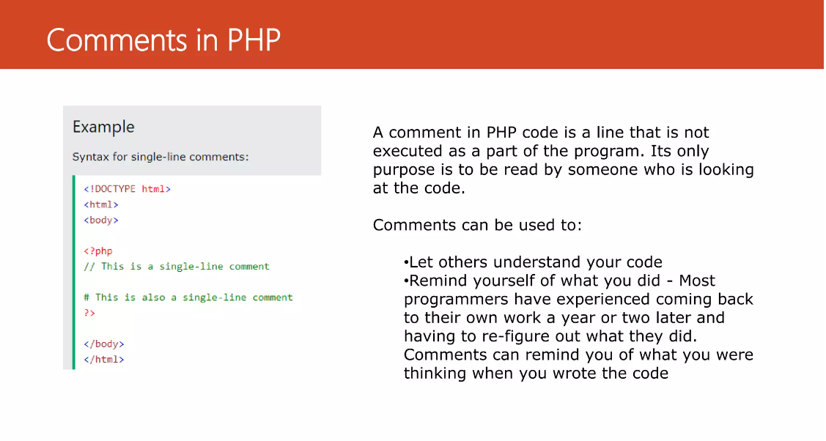

Slide 21
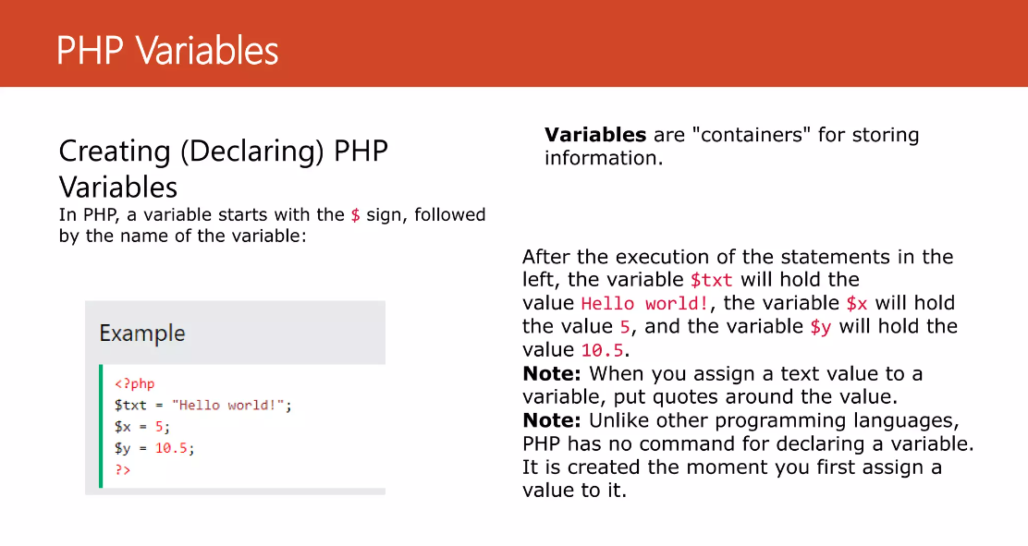

Slide 22
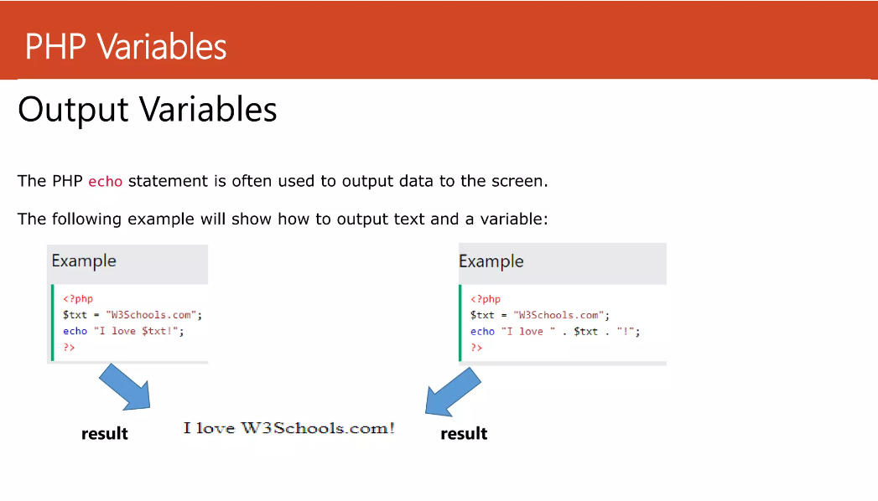

Slide 23
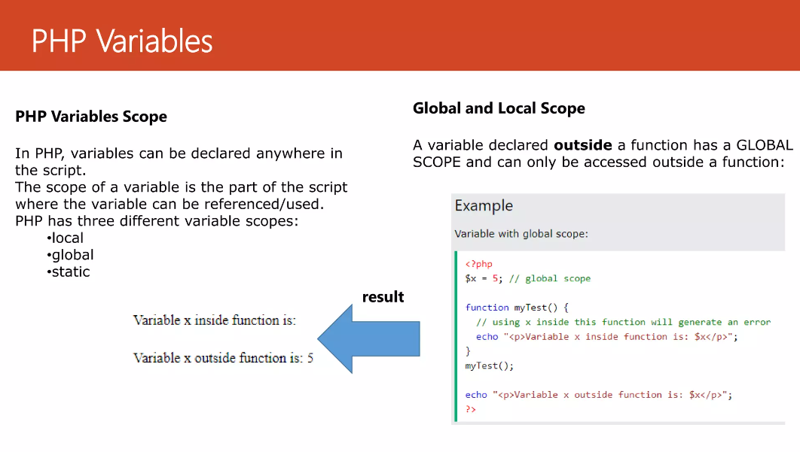

Slide 24
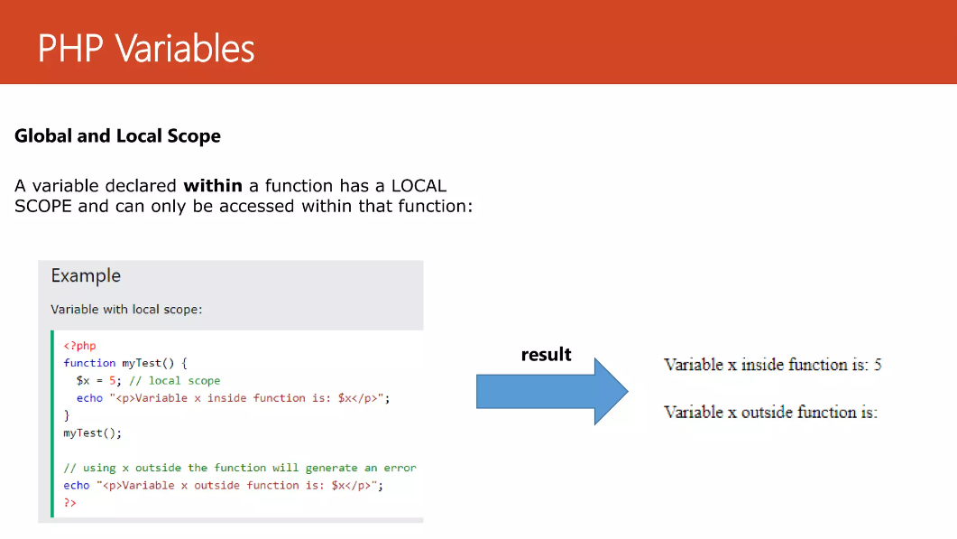

Slide 25
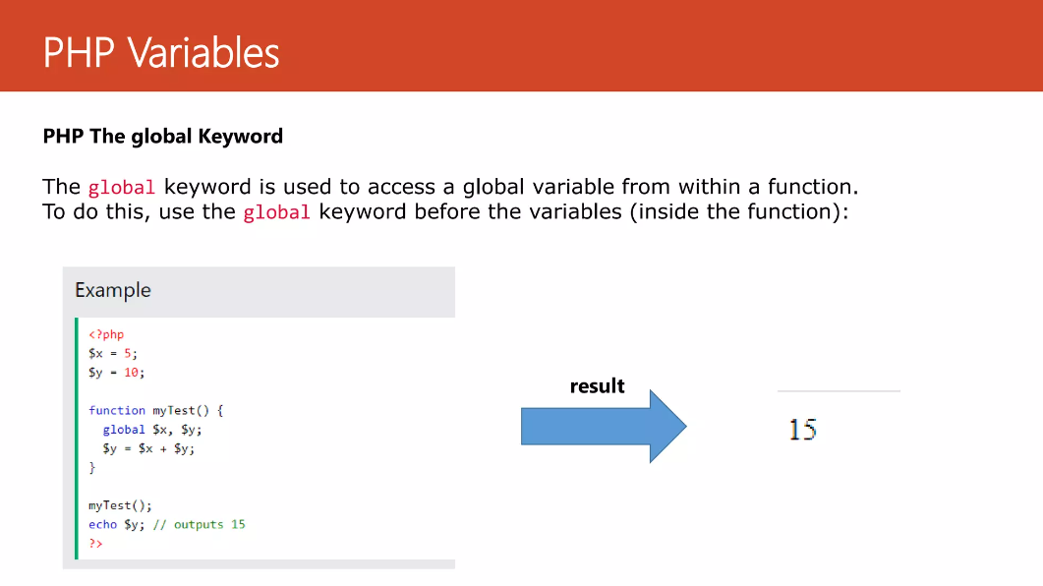

Slide 26
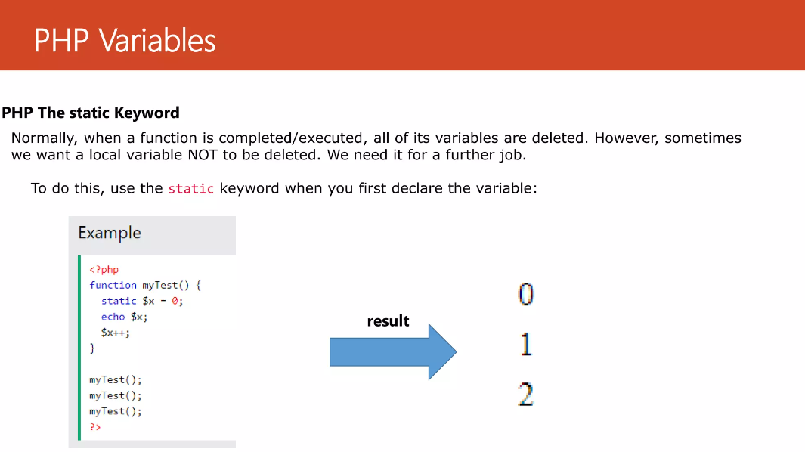

Slide 27
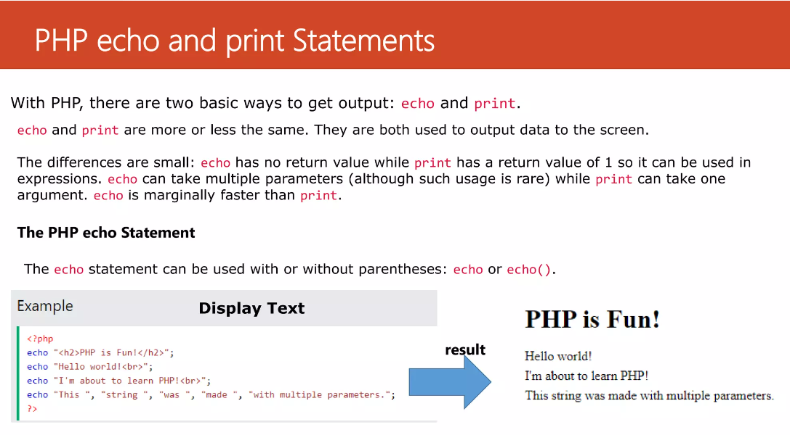

Slide 28
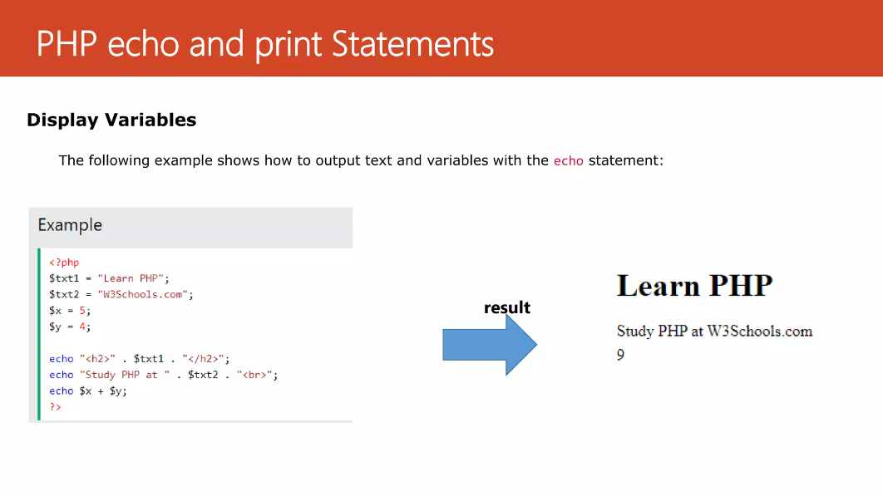

Slide 29
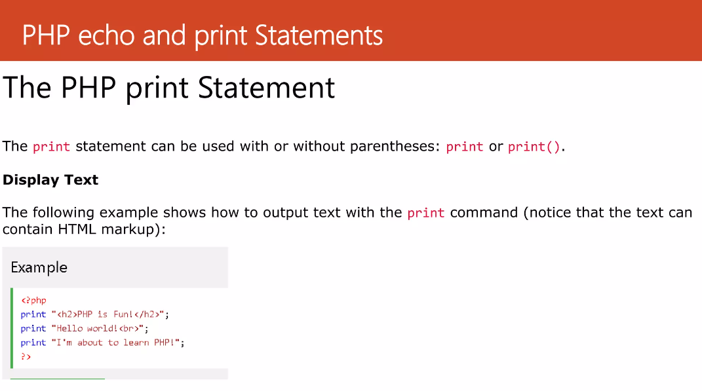

Slide 30
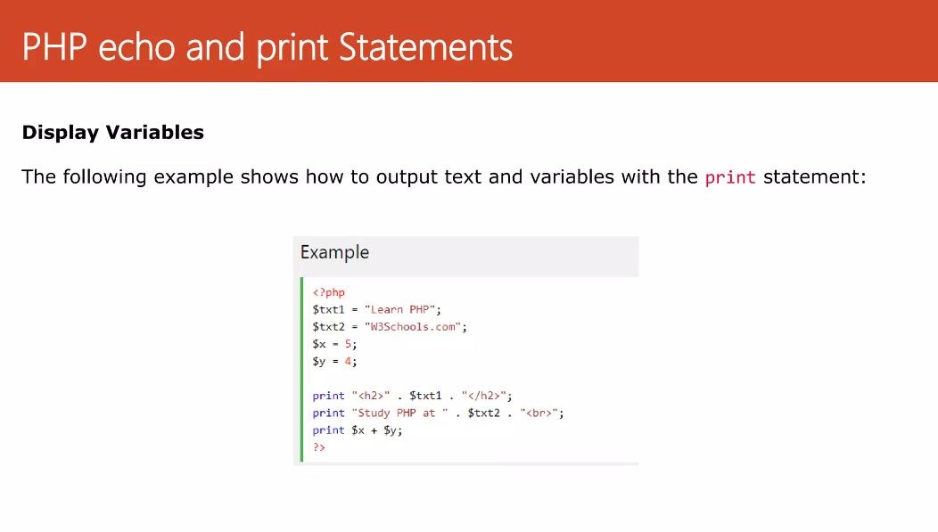

Slide 31
Variables (I)
To use or assign variable $ must be present before the name of the variable
The assign operator is '='
There is no need to declare the type of the variable
the current stored value produces an implicit type-casting of the variable.
A variable can be used before to be assigned
$A = 1;
$B = “2”;
$C = ($A + $B); // Integer sum
$D = $A . $B; // String concatenation
echo $C; // prints 3
echo $D;// prints 12

Slide 32
Variables (II)
Function isset tests if a variable is assigned or not
$A = 1;
if (isset($A))
print “A isset”
if (!isset($B))
print “B is NOT set”;

Slide 33
Strings (I)
A string is a sequence of chars
$stringTest = “this is a sequence of chars”;
echo $stringTest[0]; output: t
echo $stringTest; output: this is a sequence of chars
A single quoted strings is displayed “as-is”
$age = 37;
$stringTest = 'I am $age years old'; // output: I am $age years old
$stringTest = “I am $age years old”; // output: I am 37 years old
Concatenation
$conc = ”is “.”a “.”composed “.”string”;
echo $conc; // output: is a composed string
$newConc = 'Also $conc '.$conc;
echo $newConc; // output: Also $conc is a composed string

Slide 34
Strings (II)
Explode function
$sequence = “A,B,C,D,E,F,G”;
$elements = explode (“,”,$sequence);
// Now elements is an array with all substrings between “,” char
echo $elemets[0]; // output: A;
echo $elemets[1]; // output: B;
echo $elemets[2]; // output: C;
echo $elemets[3]; // output: D;
echo $elemets[4]; // output: E;
echo $elemets[5]; // output: F;
echo $elemets[6]; // output: G;

Slide 35
Arrays (I)
Groups a set of variables, every element stored into an array as an associated key (index to retrieve the element)
$books = array( 0=>”php manual”,1=>”perl manual”,2=>”C manual”);
$books = array( 0=>”php manual”,”perl manual”,”C manual”);
$books = array (“php manual”,”perl manual”,”C manual”);
echo $books[2]; output: C manual
Arrays with PHP are associative
$books = array( “php manual”=>1,”perl manual”=>1,”C manual”=>1); // HASH
echo $books[“perl manual”]; output: 1
$books[“lisp manual”] = 1; // Add a new element

Slide 36
Arrays (II)
Working on an arrays
$books = array( ”php manual”,”perl manual”,”C manual”);
Common loop
for ($i=0; $i < count($books); $i++)
print ($i+1).”-st book of my library: $books[$i]”;
each
$books = array( “php manual”=>1,”perl manual”=>2,”C manual”=>3);
while ($item = each( $books )) // Retrieve items one by one
print $item[“value”].”-st book of my library: ”.$item[“key”];
// each retrieve an array of two elements with key and value of current element
each and list
while ( list($value,$key) = each( $books ))
print “$value-st book of my library: $key”;
// list collect the two element retrieved by each and store them in two different // variables

Slide 37
Arrays (III)
Multidimensional arrays
$books = array( array(“title”=>“php manual”,”editor”=>”X”,”author”=>”A”),
array(“title”=>“perl manual”,”editor”=>”Y”,”author”=>”B”),
array(“title=>“C manual”,”editor”=>”Z”,author=>”C”));
Common loop
for ($i=0; $i < count($books); $i++ )
print “$i-st book, title: ”.$books[$i][“title”].” author: “.$books[$i][“author”].
“ editor: “.$books[$i][“editor”];
// Add .”\n” for text new page or “.<BR>” for HTML new page;
Use list and each
for ($i=0; $i < count($books); $i++)
{
print “$i-st book is: “;
while ( list($key,$value) = each( $books[$i] ))
print “$key: $value ”;
print “<BR>”; // or “\n”
}

Slide 38



Example
Lets create our first task

Slide 39


The End
in the end I hope you understood all I said contact on :
https://www.facebook.com/abobakr143
https://wa.me/201113284597

